Slide 1

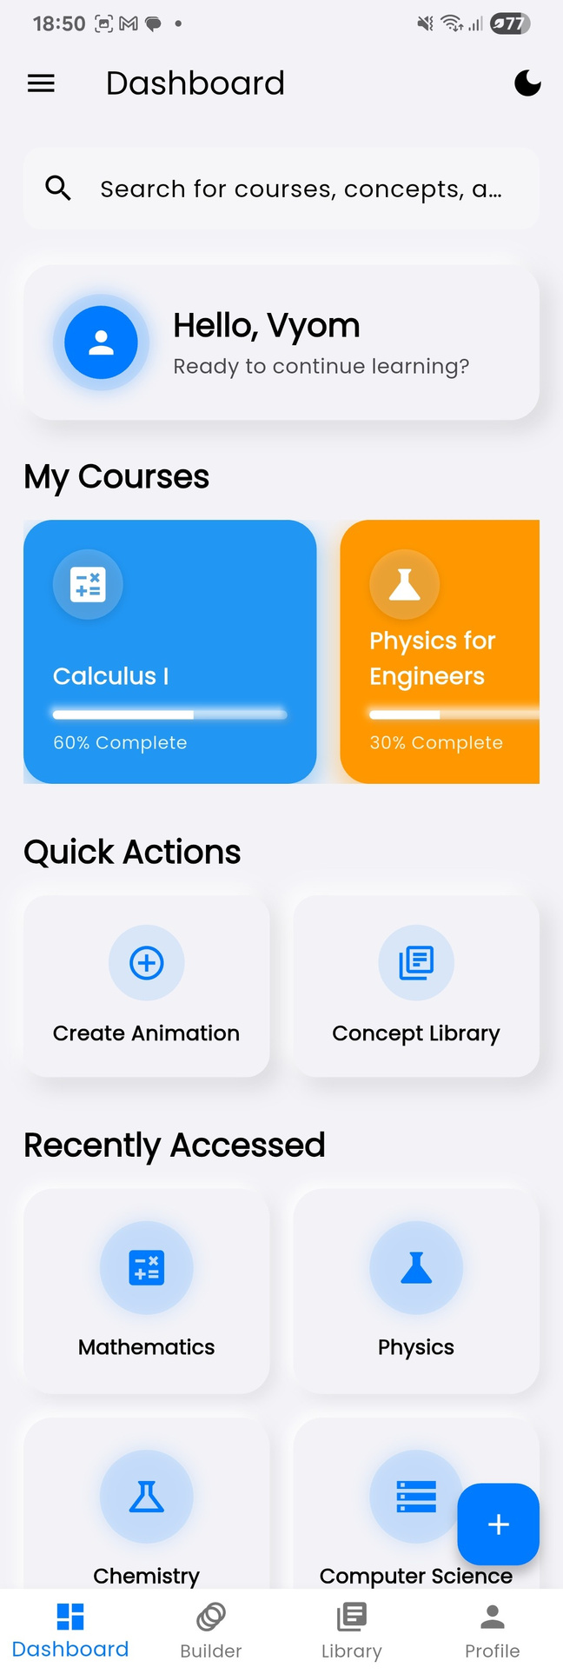

PANDORA
Vyom N. Patel, Vrushal Modh
AI E-250500
Problem Statement 2

Slide 2
Problem Statement
STEM education in India is too theoretical—students struggle to visualize Maths & Physics. Existing AI videos lack accuracy and consistency.
Challenges:
  Precise real-time visualization of equations
  Consistent, adaptive AI content
  Offline + low-RAM performance
  Multilingual & cross-device support
Users:
Rural students & teachers
Success Metrics:
<1.5s render time • 10K+ users • 90% NCERT coverage

Slide 3

Solution Overview
Pitch:
An AI-powered STEM learning platform that transforms abstract Maths & Physics concepts into precise, interactive visualizations, combining generative AI with verified scientific rendering tools like and LaTeX.
User Journey:
Before: Static notes, theoretical lectures, inconsistent AI visuals.
After: Interactive, accurate, multilingual visual lessons accessible on any device.
Expected Impact:
  Improved conceptual understanding & engagement
  Scalable access for low-resource schools and NGOs
  Reduced learning gap in rural STEM education
Alignment with Problem Statement:
Directly addresses the lack of visual, adaptive, and accurate STEM content by merging AI adaptability with scientific precision.
Key Differentiators:
  Real-time, accurate equation-to-animation generation
  Visual + mathematical consistency across topics
  Adaptive learning personalized to each student

Slide 4
Solution Architecture
Hybrid cloud architecture using Flutter frontend, Firebase Auth, MongoDB content library, OpenRouter AI, and a custom API (api.vyxm.in) hosted on an Raspberry Pi server for online content generation.
Core Components:
  Frontend: Flutter app (Android, Desktop)
  Backend: Firebase (Auth), MongoDB & Node.js(content library)
  AI/ML: OpenRouter models for adaptive learning & AI explanations
  Custom API: api.vyxm.in (Raspberry Pi server) for AI PPT generation & integration
  Cloud Render: processing (math/physics animations – heavy compute)
Cloud vs Local:
  Cloud: AI + rendering (compute-heavy)
  Local: Content viewing, caching, quizzes
Scalability:
Modular microservices, CDN caching, load-balanced cloud rendering, and containerized Raspberry Pi endpoints for distributed scaling.

Slide 5
Frontend:
  Flutter – Cross-platform (Android, Desktop, Web) for unified UI & fast deployment.
Backend:
  Python + Flask – Lightweight, async, ideal for AI API integration and low-latency responses.
AI/ML Layer:
  OpenRouter APIs (Llama-3 Maverick & Kimi K2) – Adaptive learning, content generation and manim code generation.
  Custom Manim Engine – Math/Physics animation rendering.
Database:
  MongoDB – Scalable NoSQL for content library & metadata.
  Firebase – Auth, analytics, and real-time sync.
Infrastructure:
  api.vyxm.in (Raspberry Pi Server) – Custom API endpoint for AI Edu PPTs.
  Cloud: Raspberry Pi Server for Manim rendering
DevOps:
  Docker for containerized deployment.
Why These Choices:
  Flutter ensures cross-device reach.
  Python is ideal for AI-heavy workloads.
  MongoDB handles Content library explainatory videos.
  OpenRouter + Manim deliver accurate, dynamic STEM visuals.
  Hybrid deployment (Pi + Locally Cached) balances performance & scalability
Tech Stack

Slide 6

of
FEATURES
OVERVIEW
PANDORA

Slide 7
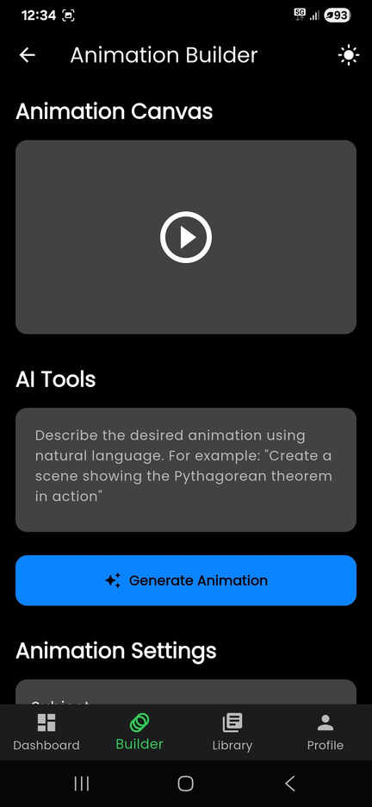
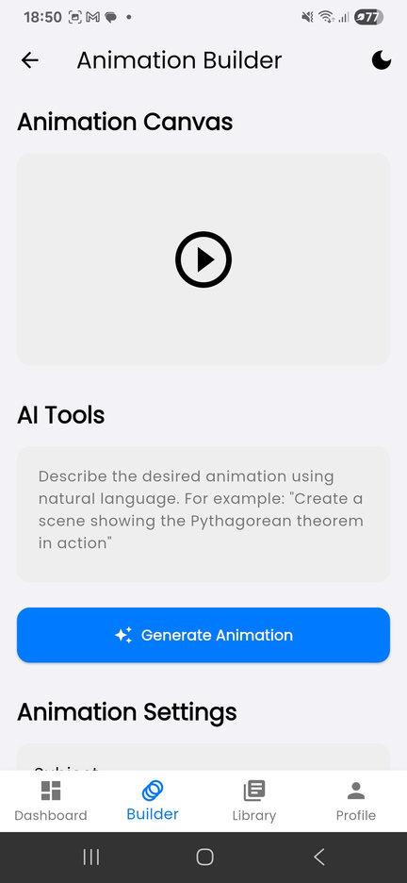
AI Animation Builder
Pandora’s core engine uses LLMs (such as Maverick and Kimi-K2) to translate natural language prompts into executable scripts that we automatically render in our render pipeline with error checks and visual consistency checks and give the student production quality videos in minutes.

Slide 8
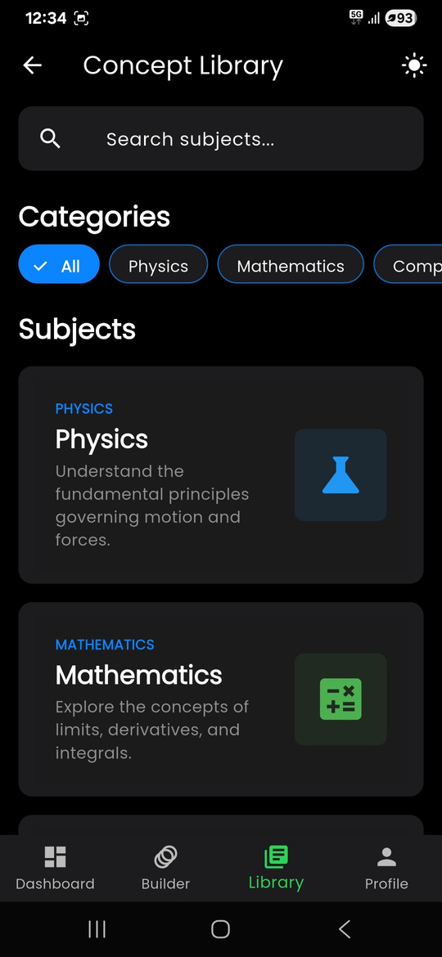
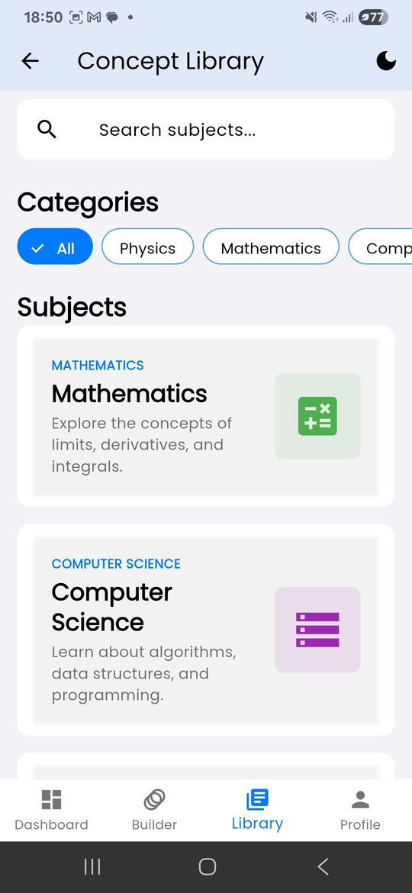
Concept Library
A curated library of tutor-led concept videos accompanies AI-generated animations. Educators can contribute verified, high-quality content aligned with Pandora’s visualizations, blending human expertise with AI precision.

Slide 9
Custom .pandora File Format
Pandora introduces a new .pandora document format, combining the readability of LaTeX with the interactivity of animations.
Each file includes:
  Animated examples embedded within latex
  Linked DPPs (Daily Practice Problems) directly connected to concepts
  Interactive step-by-step visual solutions
  These files can be opened within Pandora, allowing students to explore problems visually and intuitively, even offline.

Slide 10
AI/Ml
PIPELINE
Optimization Techniques:
  Response caching for repeated queries.
  Error checks and loop querying
  Prompt compression & token-efficient formatting.
Inference Pipeline:
  User query → Parsed by frontend
  Routed to api.vyxm.in → OpenRouter (LLM) generates text
  If visualization needed → Manim render service triggered
  Output merged & returned to user app
  Cached for offline reuse
Model Selection:
  OpenRouter APIs (GPT/Claude family) for text & explanation generation.
  Custom Manim Engine for visual rendering of Maths/Physics content.
  Selection driven by accuracy, reasoning depth, and multilingual adaptability.
Prompt Engineering:
  Structured multi-part prompts.
  Context-aware templates ensure consistent style, tone, and accuracy.
Caching & Performance:
  Layered caching (API + local device).
  Render outputs stored for replay without reprocessing.
Edge vs Cloud Inference:
  Cloud: Heavy LLM + Manim rendering (compute intensive).
  Edge (Device): Light reasoning, offline caching, and content playback for low-bandwidth use.

Slide 11
Data Architecture
Pandora stores structured metadata in MongoDB Atlas and user media in Firebase Storage; small client state (tokens, preferences) is kept locally via shared preferences.
Core entities:
  Users: profile, email, hobbies, hashed password
  Library Videos: title, YouTube URL, subject, chapter
  Courses: title, description, list of Library Video reffrences
  Animations: topic, generated video URL, creator user ID
  Recently Accessed: user ID + content reference (video or animation)
Relationships & model:
one-to-many (User → Animations, Course → Library Videos); many-to-many achieved via Recently Accessed for activity/recommendations.
Content flow & management: vet → categorize → enrich metadata → insert into DB (admin panel / scripts).
Security & privacy:
encrypt password hashing, JWT auth for protected APIs, HTTPS transport, encryption-at-rest for storage.

Slide 12
API Design
Auth & Authorization:
  Firebase Auth for secure login, JWT-based session tokens, and role-based access (student/teacher/admin).
Rate Limiting & Error Handling:
  Global rate limiter (per IP & token) to prevent abuse.
  Structured error responses with standardized HTTP codes.
Third-Party Integrations:
  OpenRouter API for AI content generation.
  Firebase Analytics for user metrics.
  Cloud Manim Renderer for math/physics animation processing.
API Structure:
  Flask API with JSON-based responses and both POST and GET based api calling and modular endpoints.
Key Endpoints:
  Content: /render, /query, /ppt (Manim animation trigger)
  Quiz: /quiz/get, /quiz/submit

Slide 13
UI/UX Design Approach
User Personas & Solutions:
  Rural Students: optimized assets, offline caching, lightweight screens for low-bandwidth use.
  Teachers: access to a curated, quality library and future tools for assigning or tracking content.
  Low-Literacy Users: icon-based navigation, minimal text, and animation-driven guidance for clarity.
Core Screens:
Login & Registration → personalized Dashboard → Library (Subject → Chapter → Video) → Content Viewer → Animation Builder.
Each screen maintains a consistent design language—soft color palette, rounded components, and quick-action buttons—creating an immersive, reliable learning environment.
Pandora’s design philosophy focuses on simplicity, accessibility, and engagement, ensuring a smooth experience for learners of all backgrounds. The interface is clean and distraction-free, using soft tones and consistent layouts that keep attention on learning content.
Design Principles:
  Simple & Intuitive → clear hierarchy, minimal visual noise
  Accessible & Inclusive → usable by all ability levels
  Offline-First → stable even with limited connectivity
  Consistent UI → reusable patterns and predictable motion

Slide 14
UI/UX Design Approach
Navigation Design
• Bottom Navigation Bar – Dashboard | Library | Profile
• Stack-based flow for Subject → Chapter → Video
• Deep links and consistent back navigation for easy movement
Accessibility Features
• Semantic labels for screen readers
• Dynamic text sizing and high-contrast themes
• Large tap targets (≥44 pt) for motor accessibility
• Closed captions & audio descriptions in videos
Offline-First Experience
• Local caching of recent videos and animations
• Automatic sync when online returns
• Offline indicator and retry actions
• Upload queue resumes after connectivity restored
Performance & Localization
• Vector graphics and Lottie animations for fast loading
• Lazy loading and adaptive streaming for low bandwidth
• Multi-language support and contextual help for users worldwide

Slide 15
Performance Optimization
App Size Optimization (<50 MB):
  Minified Flutter bundles & dynamic module loading.
  Compressed assets and vector-based UI elements.
Lazy Loading:
  On-demand loading for lessons, quizzes, and animations.
  Defers heavy AI/video components until required.
Caching Strategies:
  HTTP caching + service workers for offline replay and reduced API calls.
  Local caching of rendered videos and AI responses.
Image & Video Optimization:
  Compressed WebP/MP4 assets.
  Progressive streaming from api.vyxm.in/generate/videos={video_id} — API returns video location instantly, client pings endpoint until file is ready.

Slide 16
Frontend/backend Architecture
Component structure & organization
Frontend (Flutter): core contains shared logic, theme and reusable widgets; features holds self-contained modules (onboarding, auth, dashboard, library, animation_builder, profile), each with its own screens, widgets and state.
Backend (Node.js): MVC-like pattern — Models define schemas, Controllers implement business logic, Routes expose API endpoints; a separate render-worker and storage/CDN layer handle media.
State management approach
Provider (Flutter) is used for dependency injection and scoped state. It enables:
• Dependency injection of services and repositories into widget subtrees.
• Change notifications that trigger selective UI rebuilds for better performance.
Routing strategy
Material navigation with MaterialPageRoute and named routes, augmented by route guards for protected screens, deep-link support, and consistent back-stack behavior for predictable navigation.
Code organization (folder structure)
lib/ — main.dart (init + providers)
core/ — theme, config, shared widgets, common services
features/ — per-feature folders (auth, dashboard, library, animation_builder, profile)
services/ — API clients, render queue client, analytics
Reusable components library
core/widgets provides standardized UI primitives (buttons, inputs, cards, loaders, video player). Design tokens (spacing, color, typography) ensure visual consistency and faster development.
Testing strategy for frontend
• Unit tests: services, utilities, providers.
• Widget tests: component rendering, interaction and accessibility.
• Integration tests: end-to-end flows (sign-in → dashboard → play/generate → sync).
Run tests in CI with mocks for network/storage and enforce coverage gates before deploy.

Slide 17
Team Roles
Name
Vyom Nishant Patel
Vrushal Modh
Roles
AI/ML Lead, Ideation & Backend
Frontend, Ops/Infrastructure & Backend
Responsibilities
API development (api.vyxm.in), AI/ML integration (OpenRouter + Manim), backend optimization
Flutter app development, UI/UX implementation, component architecture

Slide 18
NEXT STEPS &
Phase 2 Roadmap
✅ Completed:
  Backend APIs finalized
  Frontend core screens implemented
  AI/ML integration completed
Phase 2 Goals:
  Launch pilot with partner schools/NGOs
  Add advanced visualization library (3D Manim + AR modules)
  Expand multilingual support and offline caching improvements
🚀 Next Steps:
4. Deploy & Test End-to-End – Full
system integration, QA testing,
and feedback loop (ETA: 1 week)
5. Performance Optimization & Polish,
App size reduction, caching, UI
refinements (ETA: 1.5 weeks)

Slide 19
Conclusion
Expected Impact
  Scale: Reach 10,000+ students across schools & NGOs in the first phase.
  Impact: Boost STEM conceptual understanding by 30% through visual, interactive learning.
  Sustainability: Open-source expansion, cloud + local deployment model, and NGO partnerships for continuous impact post-hackathon.
  The Problem: STEM education in India is too theoretical, limiting students’ ability to visualize abstract Maths & Physics concepts.
  Our Solution: An AI-powered platform that generates accurate, interactive visual explanations using Manim, OpenRouter AI, and adaptive learning tools.
  How We’ll Build It: Flutter frontend + FastAPI backend + OpenRouter AI + Manim rendering pipeline, deployed via api.vyxm.in.

Slide 20
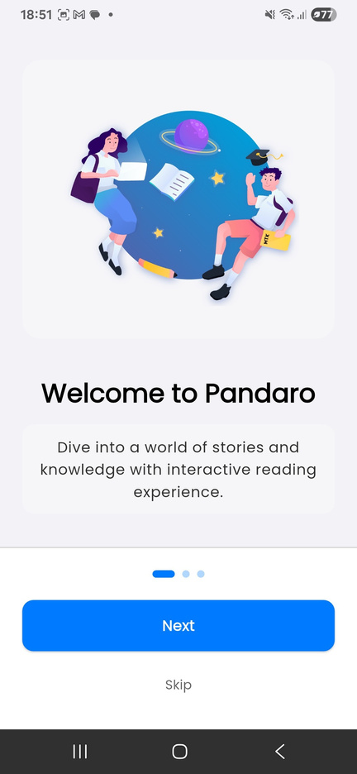
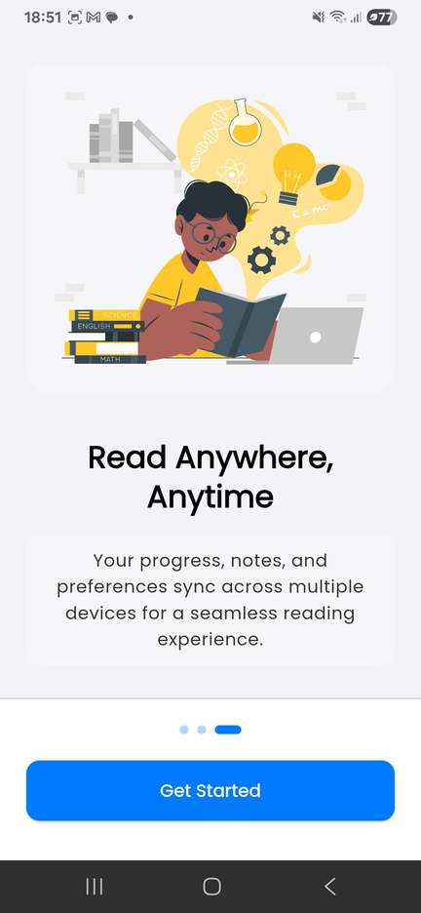
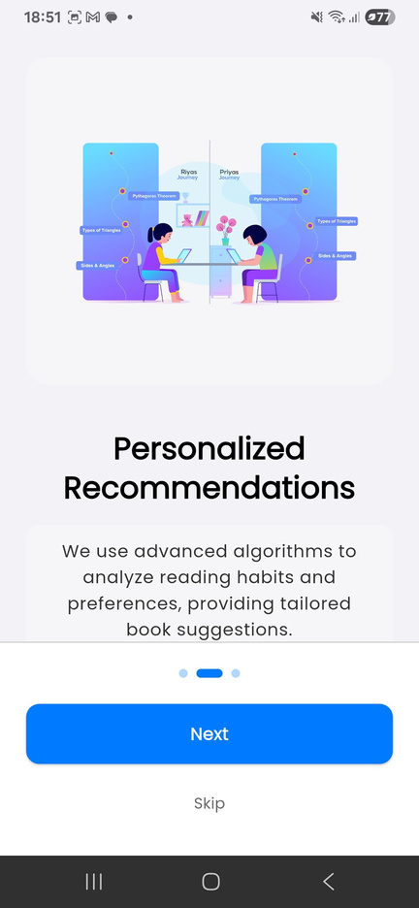
Thank You
GitHub: github.com/Vyomie/Pandora/
Team Contact:
contact@vyxm.in
Website:
pandora.vyxm.in
*All visualizations of app screens are real screenshots of the product not illustrations

